Slide 1
Christmas in USA
Supervisor Olga Valerievna Lipatova
Student Andrew Plutto
Group ITC6-12B
Moscow
BMSTU
2022

Slide 2
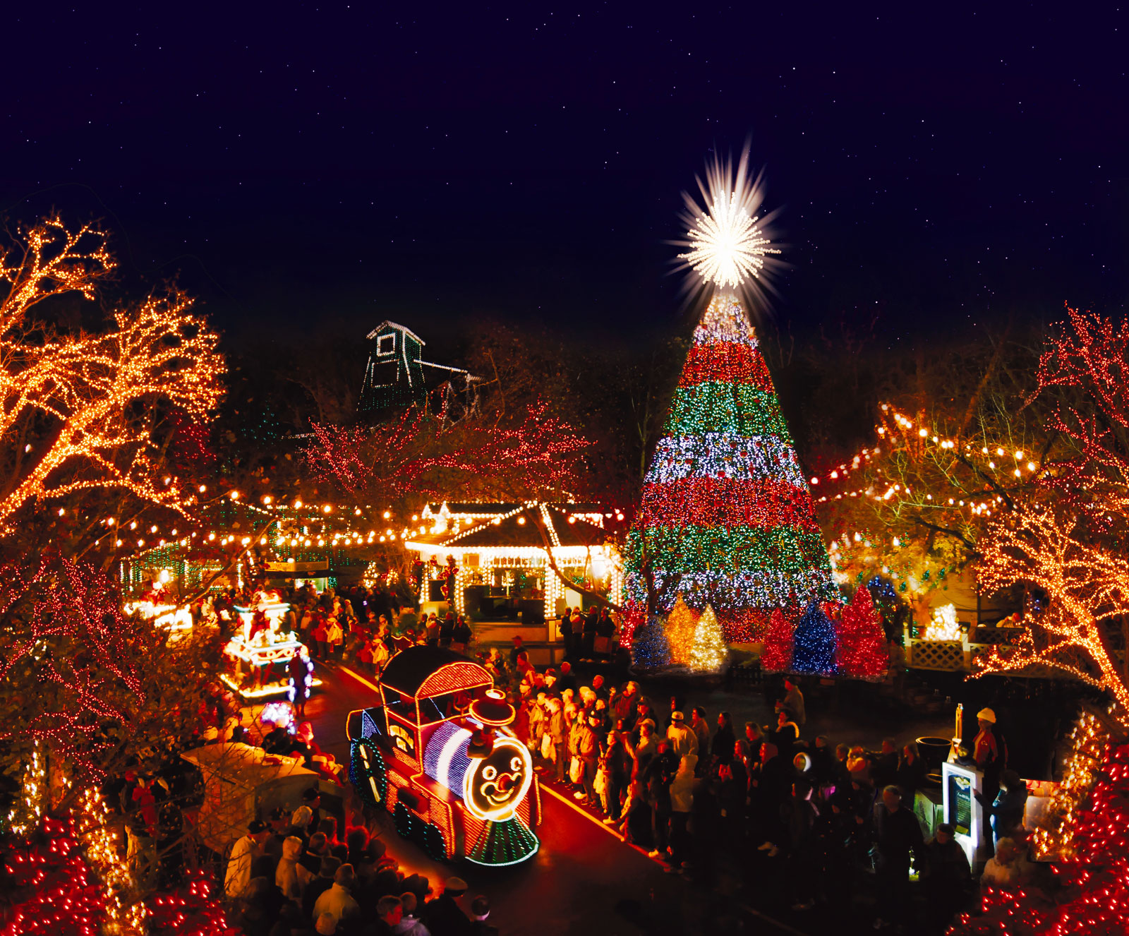
About
Christmas is celebrated on December 25 and is both a sacred religious holiday and a worldwide cultural and commercial phenomenon. For two millennia, people around the world have been observing it with traditions and practices that are both religious and secular in nature. Christians celebrate Christmas Day as the anniversary of the birth of Jesus of Nazareth, a spiritual leader whose teachings form the basis of their religion. Popular customs include exchanging gifts, decorating Christmas trees, attending church, sharing meals with family and friends and, of course, waiting for Santa Claus to arrive. December 25—Christmas Day—has been a federal holiday in the United States since 1870.

Slide 3
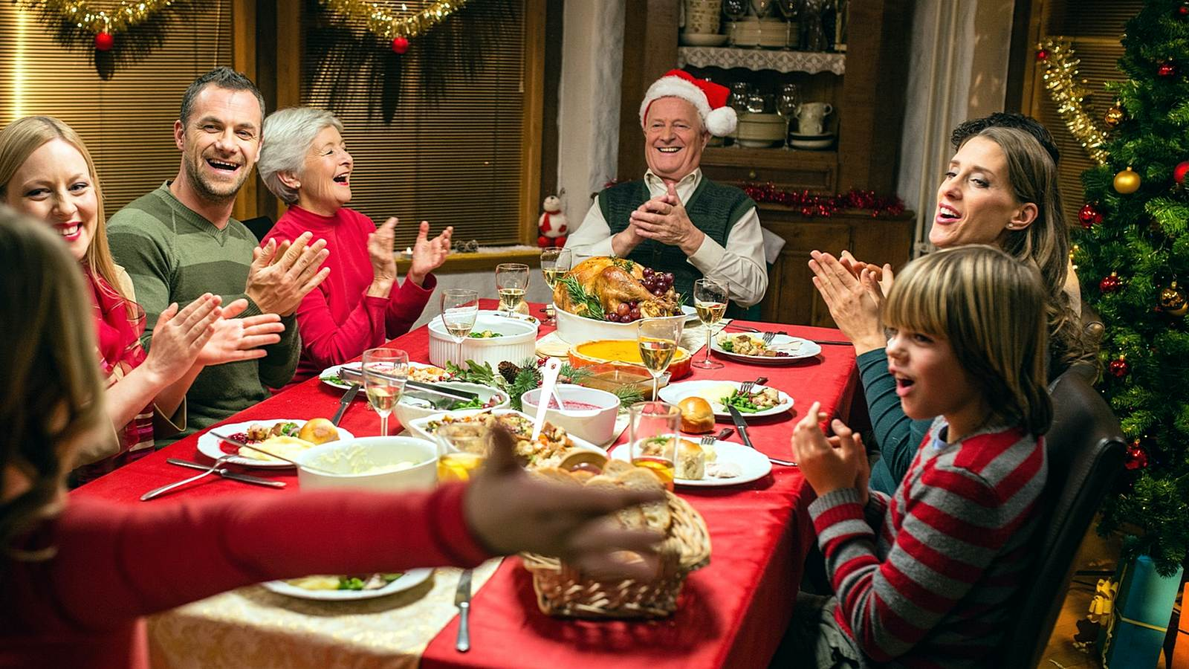
What Do People Do?
People celebrate Christmas Day in many ways. It is often combined with customs from pre-Christian winter celebrations. Many people decorate their homes, visit family or friends and exchange gifts. In the days or even weeks before Christmas Day, many people decorate their homes and gardens with lights, Christmas trees and much more.

Slide 4
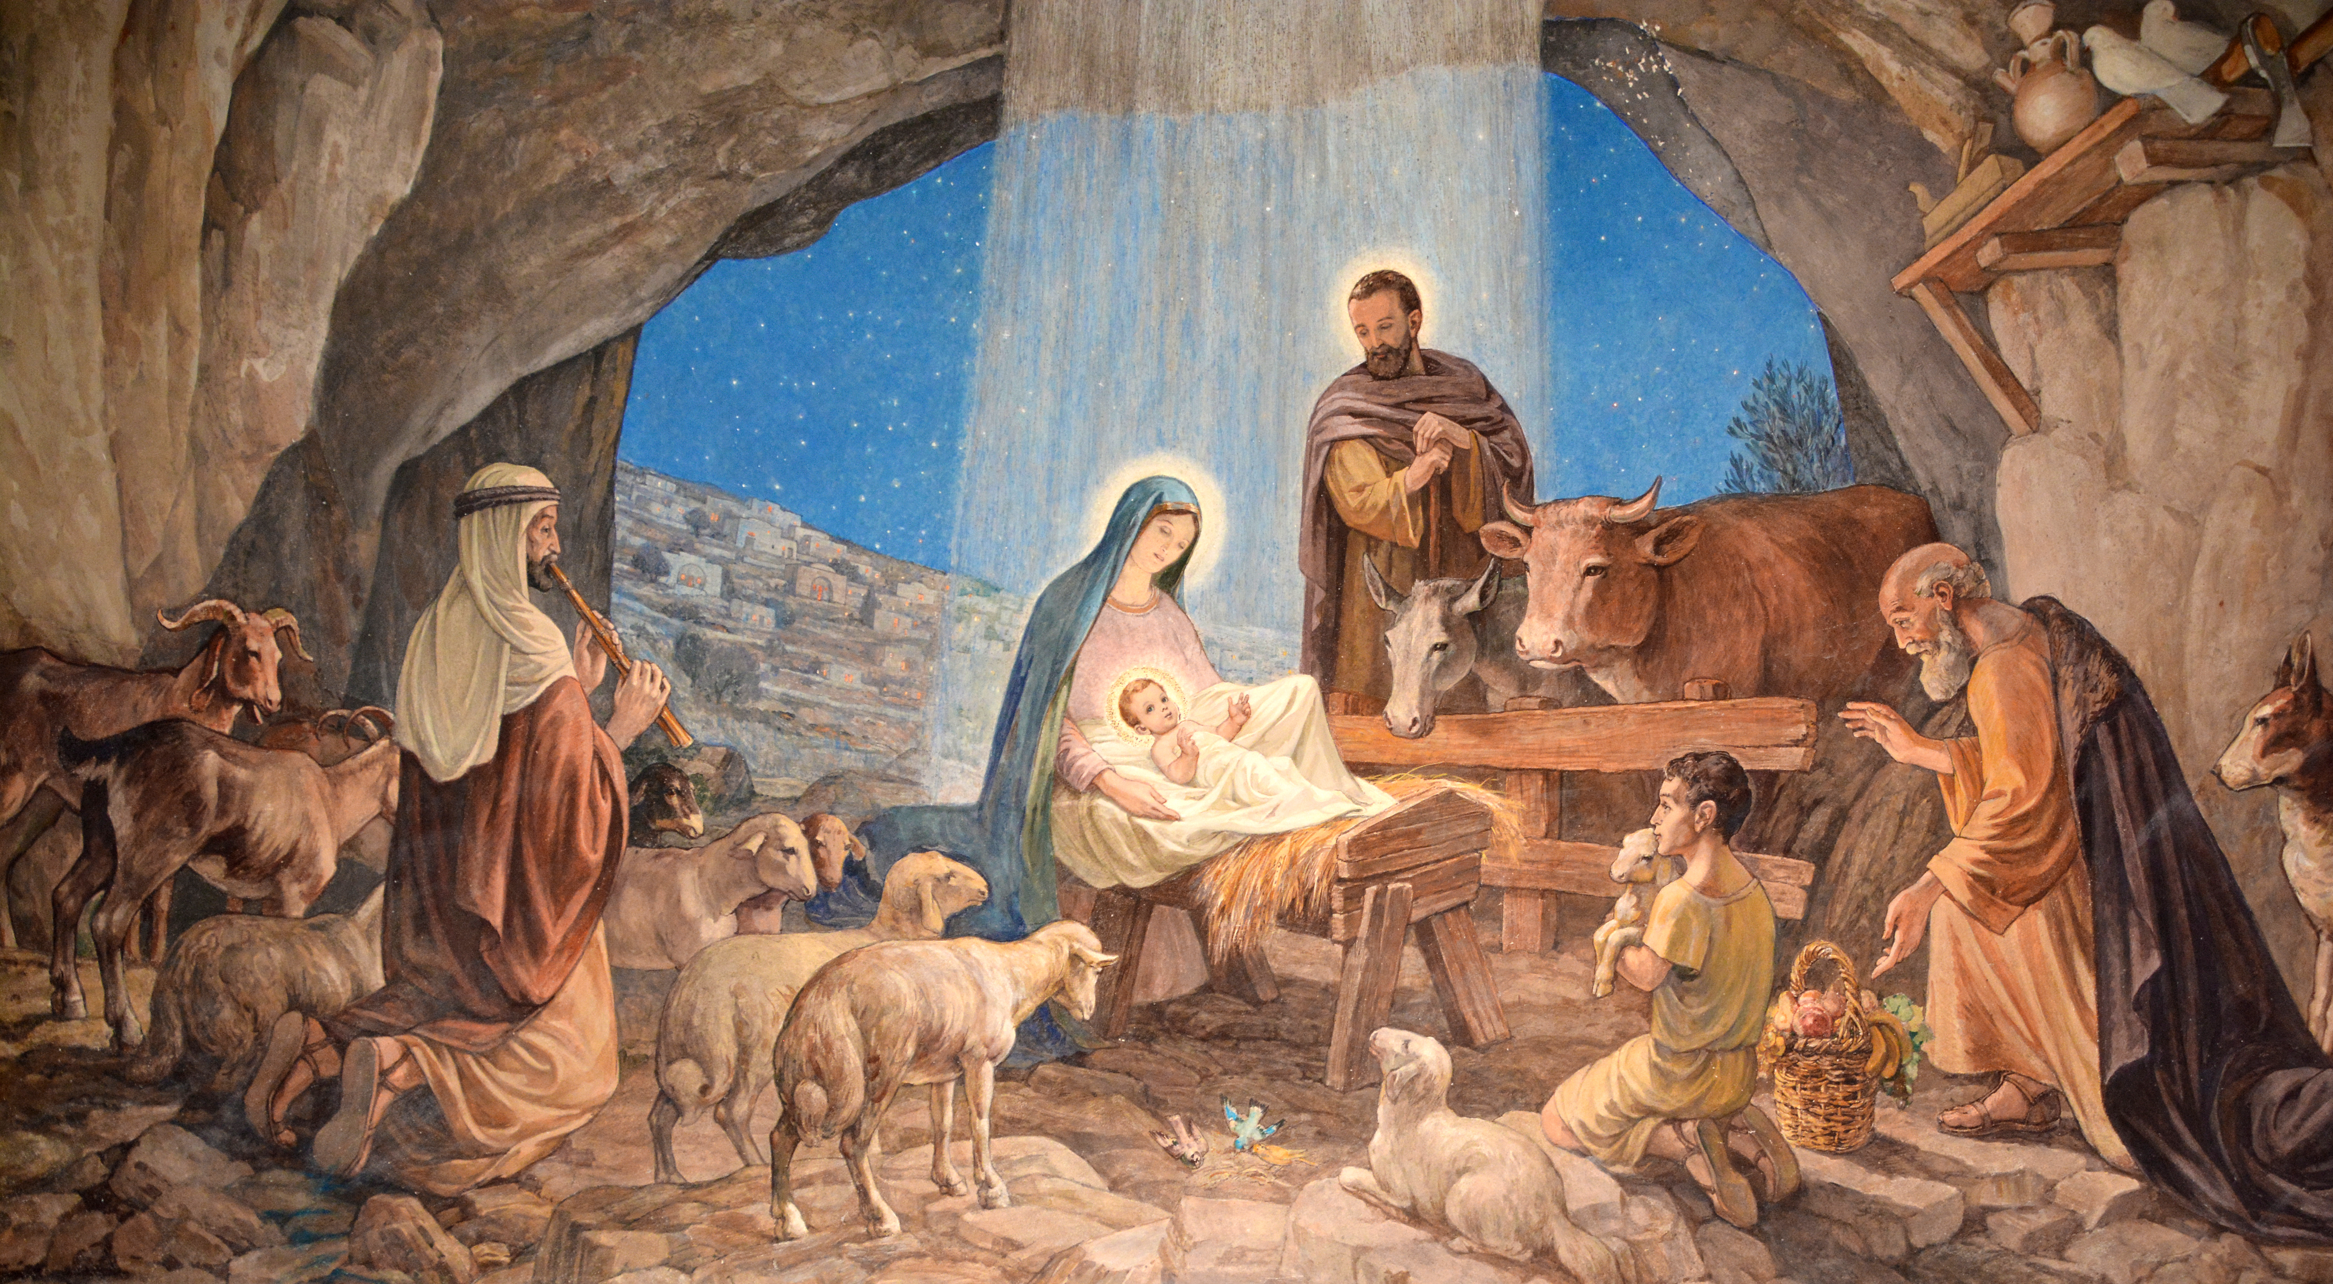
History
The original meaning of Christmas is a special church service, or mass, to celebrate the birth of Christ. The story of the Nativity, or the events surrounding the birth of Jesus, are particularly important in religious celebrations of Christmas. However, many traditions that are around today have their roots in pre-Christian winter festivals. These include the importance of candles and decorations made from evergreen bushes and tree, symbolizing everlasting light and life.

Slide 5
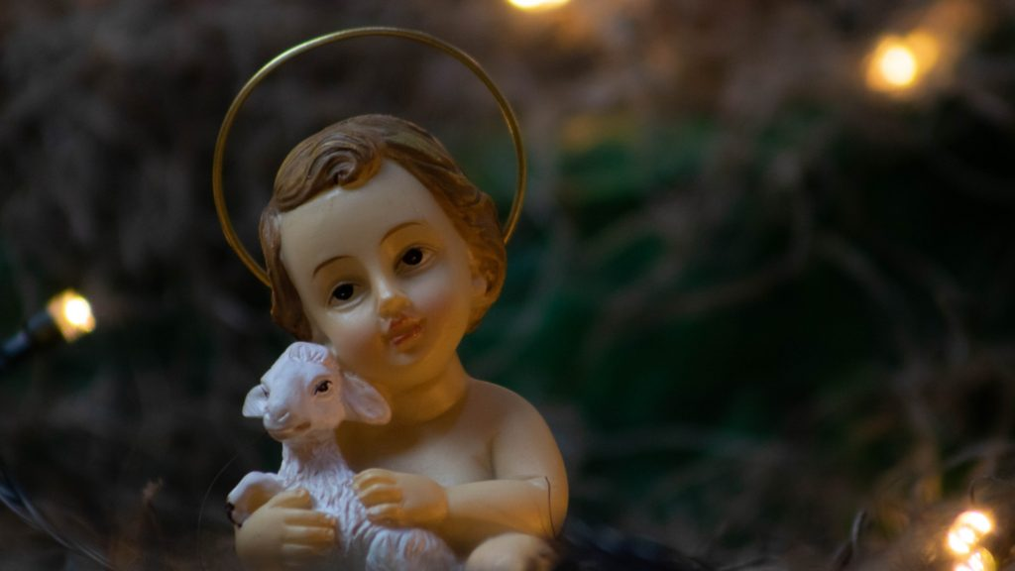
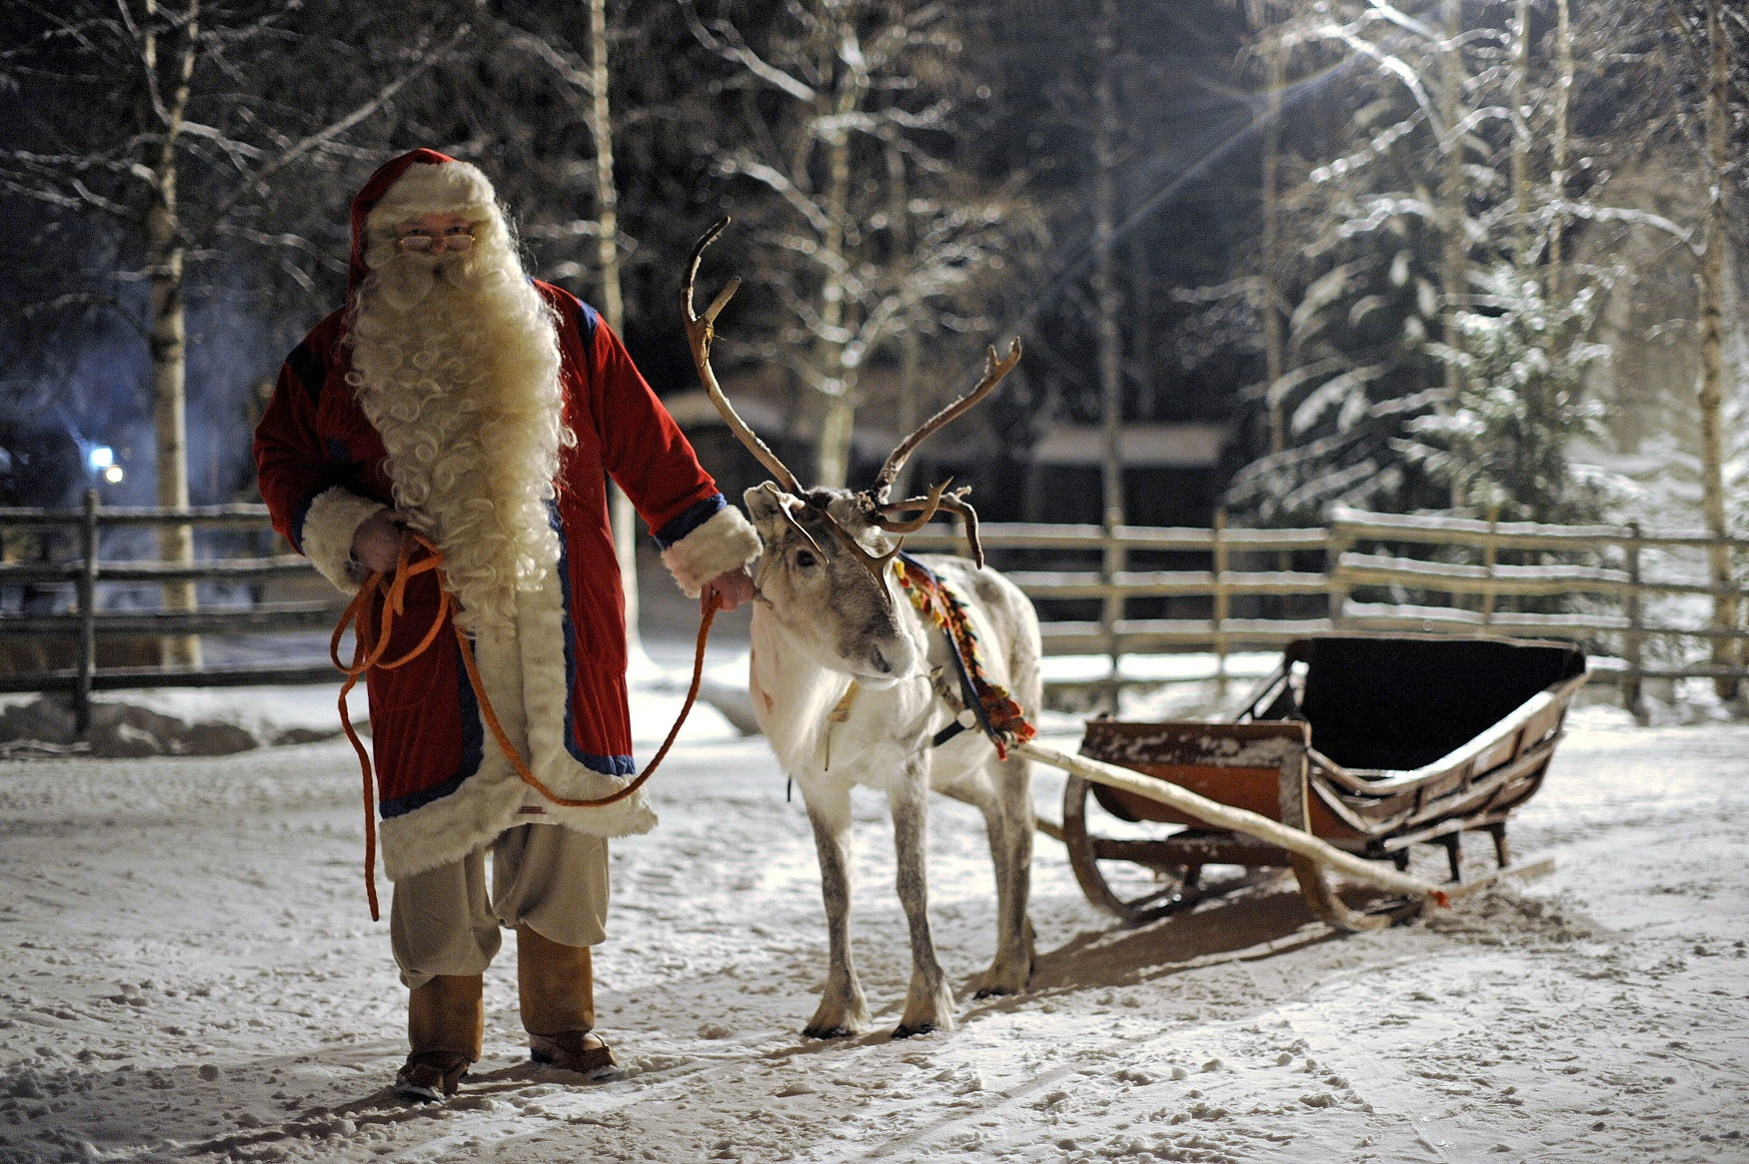
Symbols
A wide range of people and objects represent Christmas. These include baby Jesus and the Three Kings, but also Santa Claus, reindeer and elves. Common objects at this time of year are pine trees, holly, decorations, fairy lights, candles and presents. Christmas Day is now truly a mix of religious celebration and commercial interests.

Slide 6
Thank you for your attention

